Slide 1
Building scalable data pipelines using MS Fabric

Slide 2
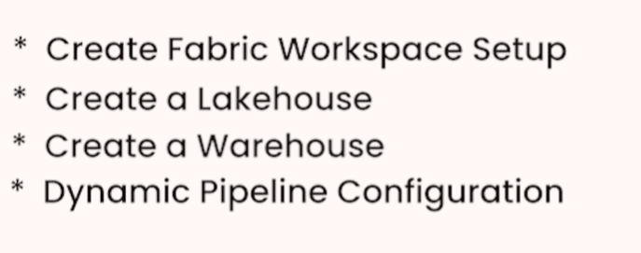

Slide 3
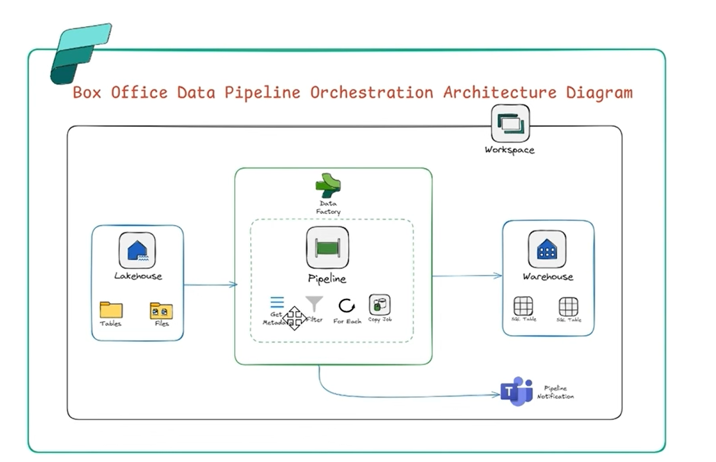

Slide 4
Creating Data Pipelines & Copy Activities (Fabric)
1. Pipeline Canvas & Visual Designer
Drag-and-drop UI to build end-to-end data movement workflows
Similar to Azure Data Factory
Activities connected using dependency conditions:
  Success
  Failure
  Completion

Slide 5
2. Copy Activity – Configuration & Settings
Core activity used to move data from source to destination
Key configurations:
  Source dataset
  Sink (target) dataset
  File format settings
  Compression & batch size
Supports full load and incremental load
🧠 Real-time example:
Copy data from SQL Server → Lakehouse → Warehouse

Slide 6
3. Source and Sink Connectors
Fabric supports 100+ connectors, including:
Databases: SQL Server, Oracle, MySQL, PostgreSQL
Cloud: Azure SQL, Azure Blob, ADLS Gen2
SaaS: Salesforce, REST API
Files: CSV, JSON, Parquet, Excel

Slide 7
4. Data Type Mapping & Schema Drift
Automatically maps source columns to target columns
Handles:
  Data type conversion
  Column renaming
  Extra/missing columns (Schema Drift)
No pipeline failure if schema changes slightly
🧠 Industry scenario:
Source adds a new column → pipeline still runs without breaking

Slide 8
5. Error Handling & Retry Policies
Configure:
  Retry count
  Retry interval
  Timeout settings
Capture failures using:
  Activity output
  Failure paths
Enables robust production pipelines
🧠 Production use:
Handle temporary network or source downtime gracefully

Slide 9
6. Performance Optimization for Copy Activities
Parallel copy
Partitioned data loading
Staging for large datasets
Compression & file sizing
🧠 Performance best practice:
Use partitioning + parallelism for large tables (>10M rows)

Slide 10
Fabric Concept | Snowflake Equivalent
Copy Activity | COPY INTO
Pipeline | Task / Workflow
Sink | Stage / Table
Schema Drift | Auto column evolution

Slide 11
Data Connectors & Pipeline Components (Microsoft Fabric)
1. Built-in Connectors
Fabric provides ready-to-use connectors to ingest data from:
Databases
SQL Server, Oracle, MySQL, PostgreSQL
Azure SQL, Synapse
Files
CSV, JSON, Parquet, Excel
Local files via gateway
Cloud Services
Azure Blob Storage
ADLS Gen2
OneLake
“Connectors are adapters that allow Fabric to talk to any data source without custom code.”

Slide 12
2. OneLake Connectors & Shortcuts
OneLake = Single data lake for entire Fabric
Shortcuts allow:
  Access data without copying
  Reuse data across Lakehouse, Warehouse, Power BI
Saves cost + storage
🧠 Real-time scenario:
Sales data stored once → accessed by:
Data Engineering
BI team
Data Science team
“OneLake shortcuts enable zero-copy data sharing across Fabric workloads.”

Slide 13
3. REST API & Web Service Connectors
Used when data is NOT in databases:
REST APIs
Web services
SaaS platforms
Supports:
GET / POST methods
Headers & authentication
Pagination
Industry example:
Fetch data from:
Payment gateway APIs
CRM systems
Weather / stock APIs

Slide 14
4. Control Flow Activities
Used to control execution logic in pipelines:
If Condition → branching logic
ForEach → loop through files or tables
Until → repeat until condition met
Example:
For each file in a folder → copy to Lakehouse
Control flow activities make pipelines dynamic and reusable.

Slide 15
5. Variables & Parameters
Parameters → passed at runtime (dynamic pipelines)
Variables → store intermediate values
Used for:
File names
Dates
Environment switching (DEV / PROD)
Example:
Load data based on:
@pipeline().parameters.RunDate

Slide 16
6. Pipeline Expressions & Functions
Fabric uses expression language (same as ADF)
Common functions:
  concat()
  substring()
  utcNow()
  equals()
Used to:
Build dynamic paths
Conditional logic
Metadata handling
“Expressions help build metadata-driven pipelines.”

